Slide 1
Intermediate Code Generation
Chapter 6

Slide 2
Intermediate Representation
Front End
Intermediate Representation
Back End
Source Program
for Language i
Target Code
for Machine j

Slide 3
Intermediate Representation
What is an Intermediate Representation (IR)?
Abstract Machine Language
Machine and Language independent version of source program
Can express target machine operation without committing too much machine specific details

Slide 4
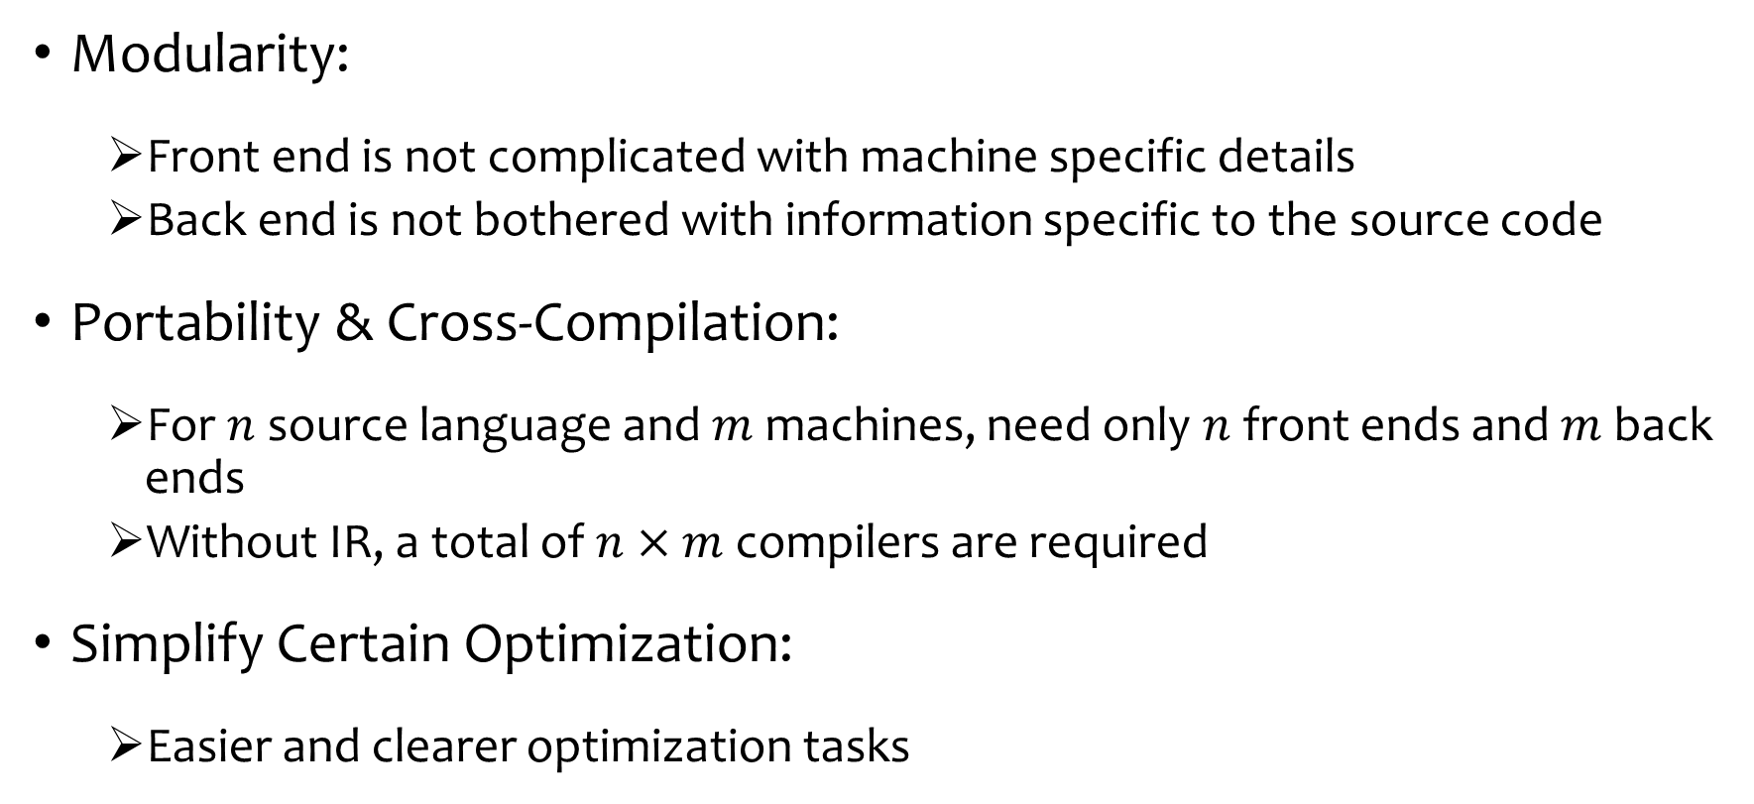
Why Need IR?
Modularity:
Front end is not complicated with machine specific details
Back end is not bothered with information specific to the source code
Portability & Cross-Compilation:
For $n$ source language and $m$ machines, need only $n$ front ends and $m$ back ends
Without IR, a total of $n×m$ compilers are required
Simplify Certain Optimization:
Easier and clearer optimization tasks

Slide 5
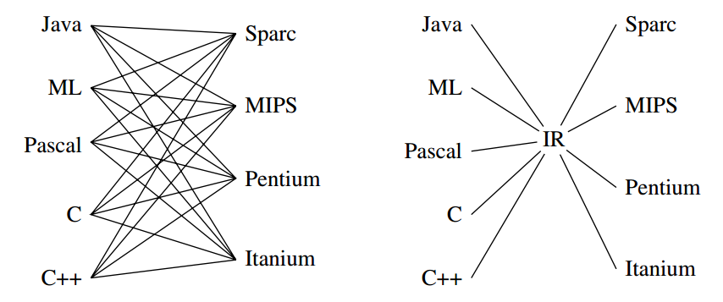
Why Need IR?
Figure Source: Modern Compiler Implementation in Java by Andrew Appel

Slide 6
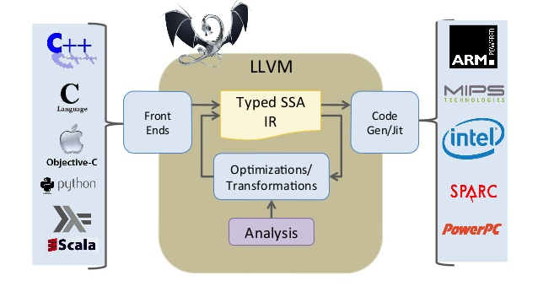
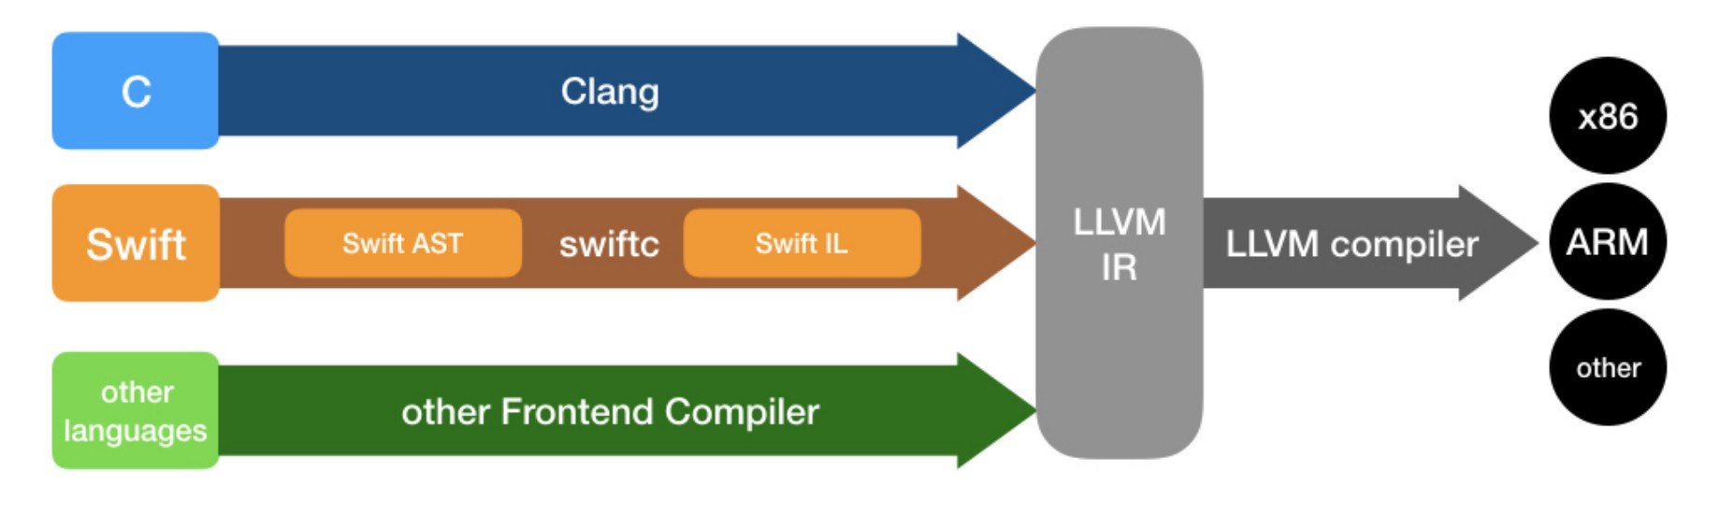
The LLVM Project https://www.llvm.org/

Slide 7
Designing Good IR?
Balance between high-level source language and low level machine language
Often there are multiple IRs in a single compiler
Source Program
High Level IR
Low Level IR
Target Code
Close to Source
Language
Close to Machine
Language

Slide 8
High and Low Level IRs
High Level IRs:
Syntax Tree
DAG
Three Address Code with high level operators
Low Level IRs:
Three Address Code with low level operators

Slide 9
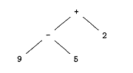
Variants of Syntax Trees
Syntax Tree:
Each node represents a construct of source program
Each children represent a meaningful component
Leaves correspond to atomic operands
Interior nodes correspond to operators
Syntax Tree for expression 9-5+2

Slide 10
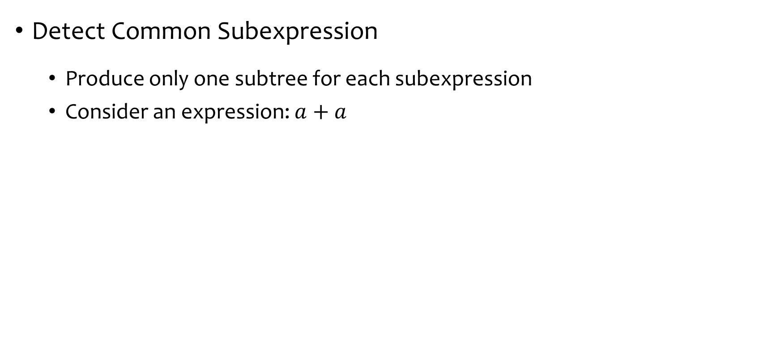
Directed Acyclic Graphs (DAG)
Detect Common Subexpression
Produce only one subtree for each subexpression
Consider an expression: $a+a$
+
+
a
a
a
Common Subexpression
Single node for expression a
Syntax Tree
DAG

Slide 11
Directed Acyclic Graphs (DAG)
A Node N can have more than one parent
If it represent a common subexpression
Succinct Representation of Syntax Tree
Provide clues for generating efficient code

Slide 12
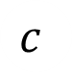

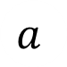

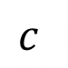
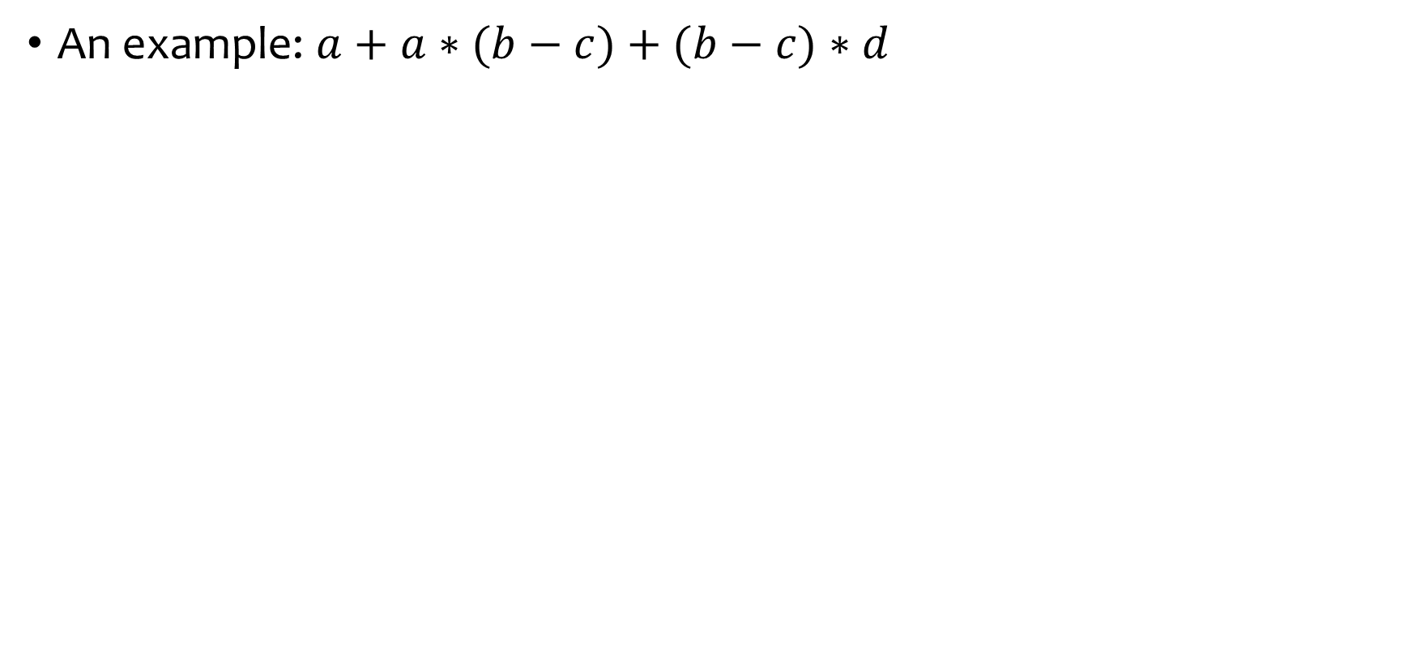
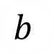




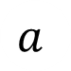
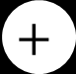
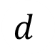
Directed Acyclic Graphs (DAG)
An example: $a+a∗(b−c)+(b−c)∗d$
$$+$$
$$+$$
$$∗$$
$$a$$
$$∗$$
$$−$$
$$d$$
$$a$$
$$−$$
$$b$$
$$c$$
$$b$$
$$c$$
Syntax Tree

Slide 13
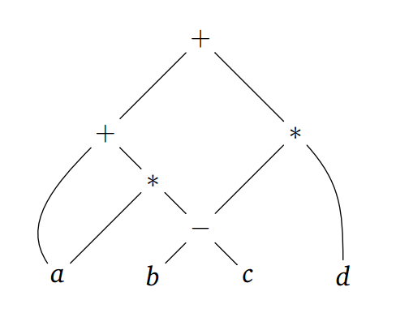












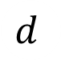
Directed Acyclic Graphs (DAG)
An example: $a+a∗(b−c)+(b−c)∗d$
$$+$$
$$+$$
$$∗$$
$$a$$
$$∗$$
$$−$$
$$d$$
$$a$$
$$−$$
$$b$$
$$c$$
$$b$$
$$c$$
Syntax Tree
DAG

Slide 14
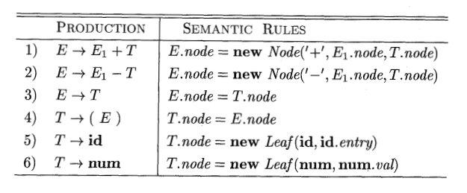
SDD for constructing DAG
Wait!! What?? This SDD constructs Syntax Tree!
The Leaf and Node functions will return a previously created identical node if exist, otherwise return a newly created one
Identical Node means the subtree rooted at that node is same

Slide 15
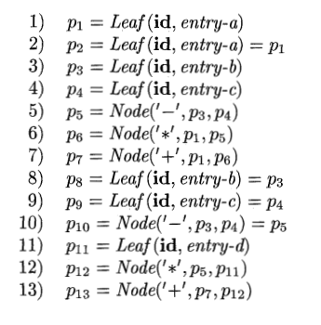
SDD for constructing DAG
DAG for expression$: a+a∗(b−c)+(b−c)∗d$
Steps of constructing the left DAG

Slide 16
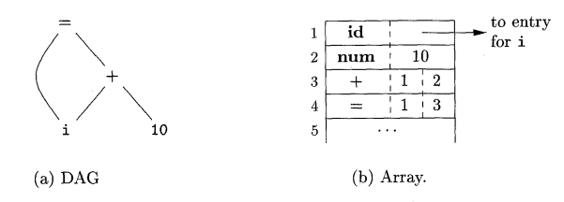
Value Number Method
Nodes of AST or DAG can be stored in array or records (structures)
Each row represent one record (one node)
Second Field of leaf node is lexical value
Second and Third Field of interior node contains index number of left and right child
First Field is an operation code (label of the node)

Slide 17
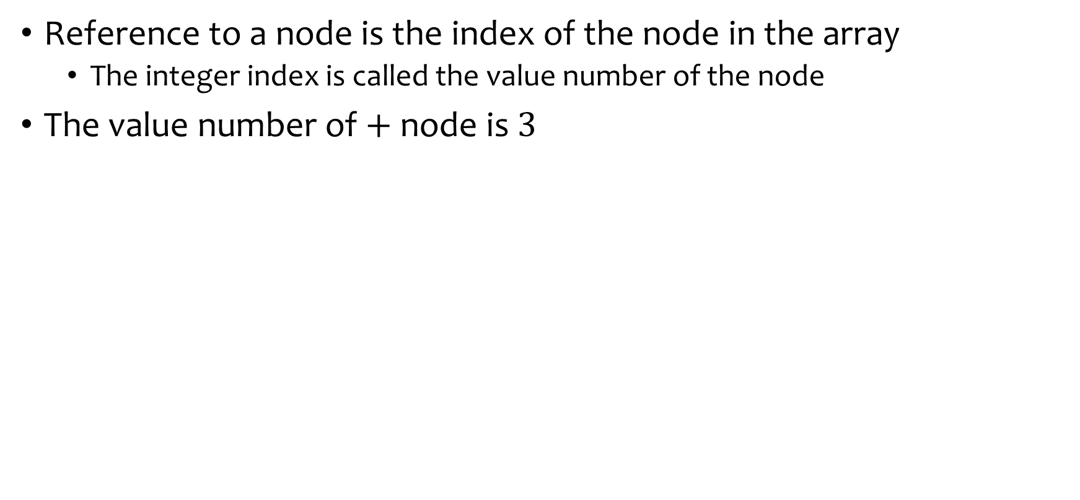
Value Number Method
Reference to a node is the index of the node in the array
The integer index is called the value number of the node
The value number of $+$ node is $3$

Slide 18
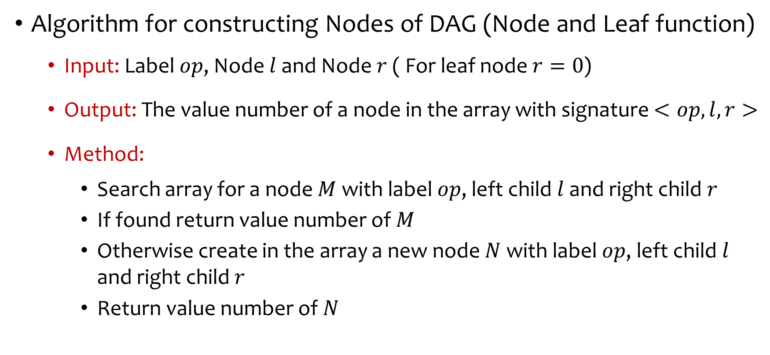
Value Number Method
Algorithm for constructing Nodes of DAG (Node and Leaf function)
Input: Label $op$, Node $l$ and Node $r$ ( For leaf node $r=0$)
Output: The value number of a node in the array with signature $<op, l, r>$
Method:
Search array for a node $M$ with label $op$, left child $l$ and right child $r$
If found return value number of $M$
Otherwise create in the array a new node $N$ with label $op$, left child $l$ and right child $r$
Return value number of $N$

Slide 19
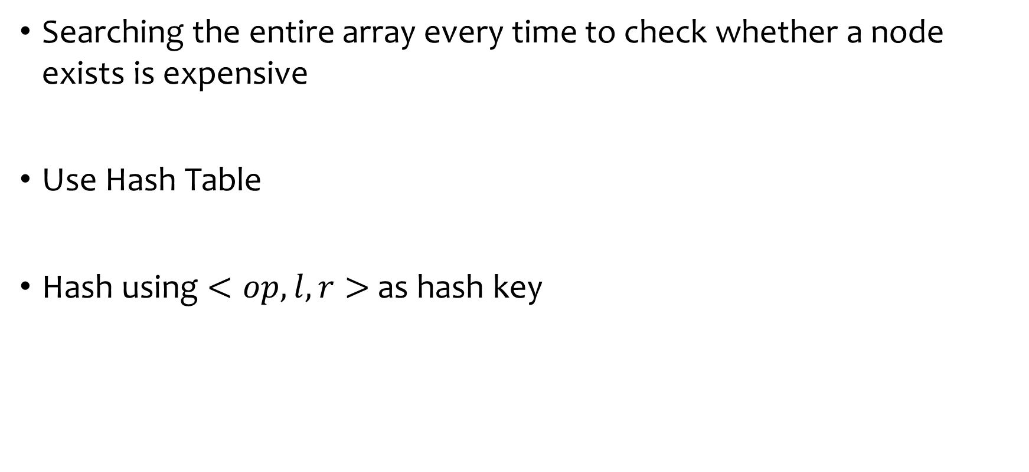
Value Number Method
Searching the entire array every time to check whether a node exists is expensive
Use Hash Table
Hash using $<op, l, r>$ as hash key

Slide 20
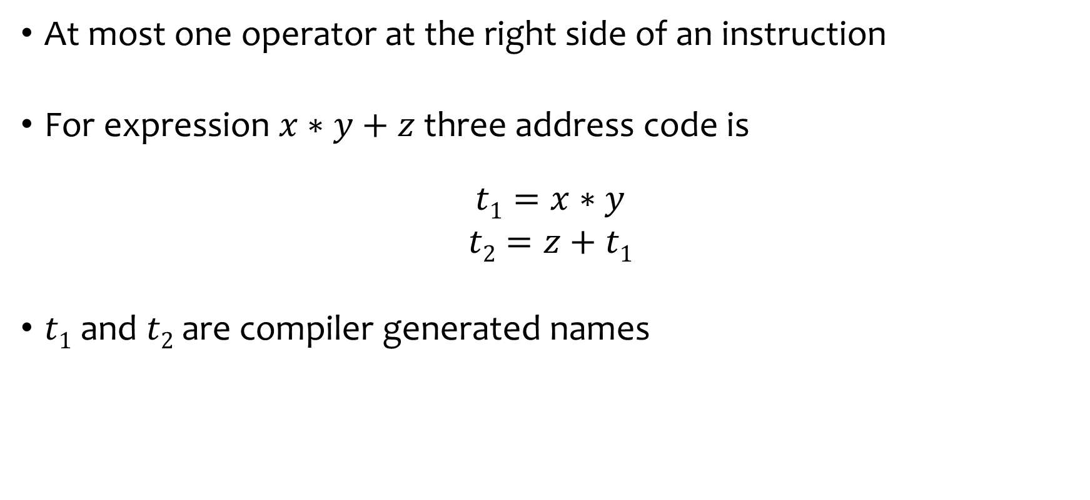
Three Address Code
At most one operator at the right side of an instruction
For expression $x∗y+z$ three address code is
$$t1=x∗y$$
$$t2=z+t1$$
$t1$ and $t2$ are compiler generated names

Slide 21
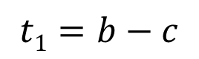
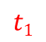
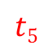
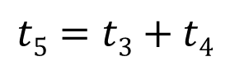
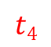
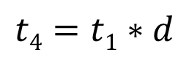
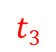
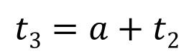
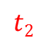
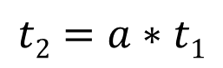
Three Address Code
Linearized representation for DAG
Explicit name corresponds to the interior nodes
Each instruction in the sequence has a label
$$t5$$
$$t1=b−c$$
$$t2=a∗t1$$
$$t3$$
$$t4$$
$$t3=a+t2$$
$$t2$$
$$t4=t1∗d$$
$$t5=t3+t4$$
$$t1$$

Slide 22
Three Address Code
Based on Two concepts:
Address
What address can be used in the code
Instruction
What kind of instruction sets can be applied

Slide 23
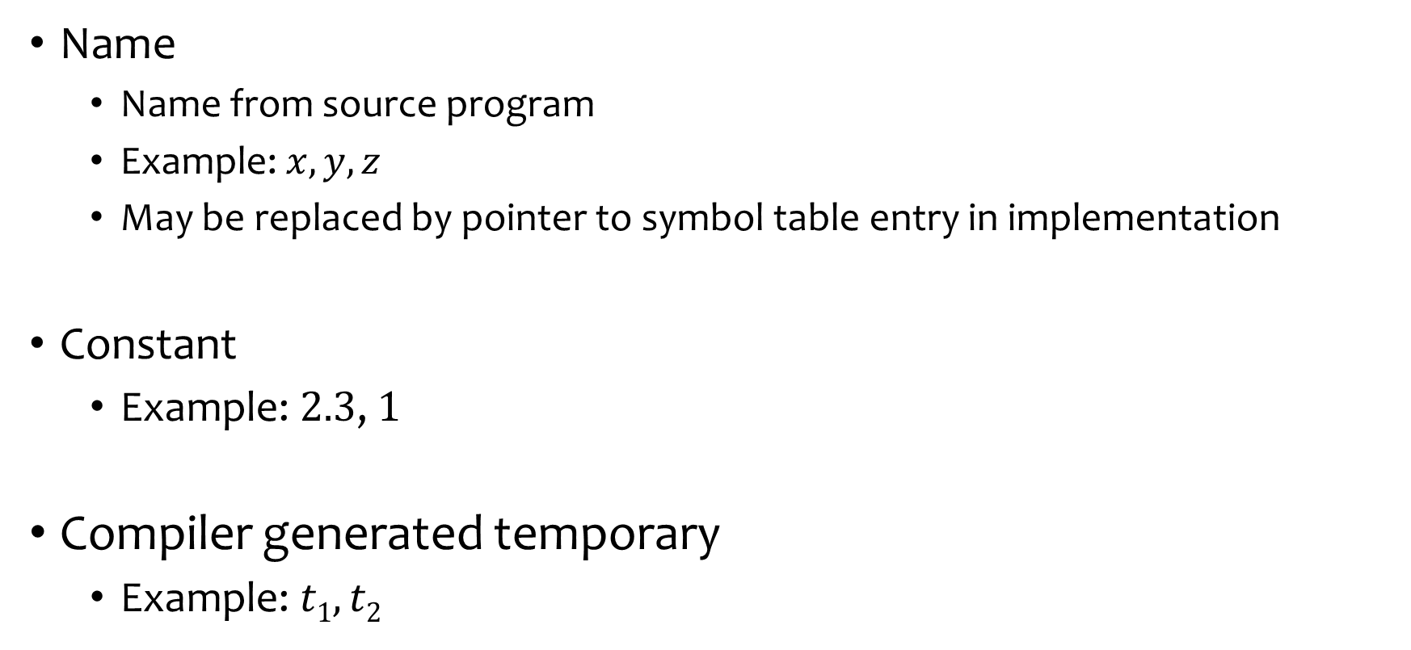
Address
Name
Name from source program
Example: $x, y, z$
May be replaced by pointer to symbol table entry in implementation
Constant
Example: $2.3$, $1$
Compiler generated temporary
Example: $t1,t2$

Slide 24
Instructions
Assignment instructions
x = y op z where x, y, z are addresses and op is a binary operator
x = op y where op is a unary operation such as unary minus, logical negation and conversion operator
Copy instruction: x = y
x is assigned the value of y
An unconditional jump : goto L
Instruction with label L is executed next
Conditional jumps:
if x goto L
ifFalse x goto L
if x relop y goto L

Slide 25
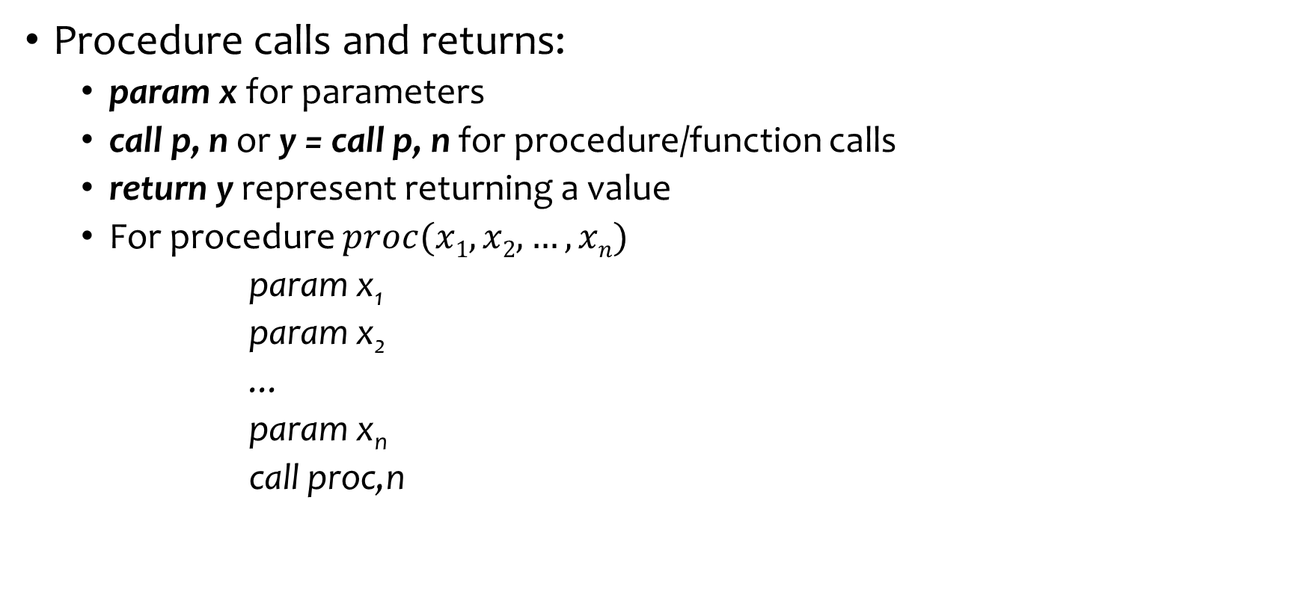
Instructions
Procedure calls and returns:
param x for parameters
call p, n or y = call p, n for procedure/function calls
return y represent returning a value
For procedure $proc(x1, x2, …, xn)$
param x₁
param x₂
...
paramx_{n}
call proc,n

Slide 26
Instructions
Indexed copy instructions:
x = y[i] sets x to the value in the location i memory units beyond location y.
x[i] = y sets the contents of the location i units beyond x to the value of y
Address and Pointers assignments:
x = & y
x = * y
* x = y

Slide 27
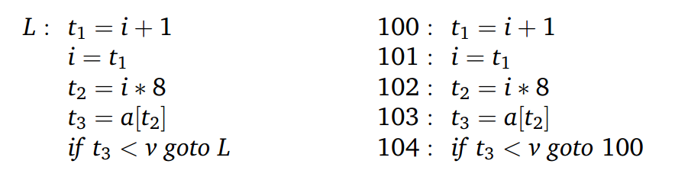
Instructions
Example: do i = i +1; while( a[i] < v );
Symbolic Labels
Position Numbers

Slide 28
Representing Three Address Code
What is the suitable data structure to represent three address code?
Can be represented using objects or record with operators and operands as fields
Three representations:
Quadruples
Triples
Indirect Triples

Slide 29
Quadruples
Four Fields:
op – represent operator
arg1, arg2 – holding operands
result – hold result of the operation
Exceptions:
Unary Operators: no arg2
param operator: no arg2, no result
(Un)conditional jump: target label is the result

Slide 30
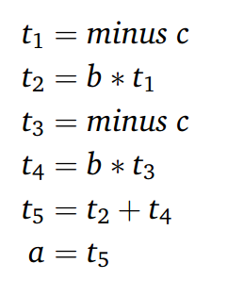
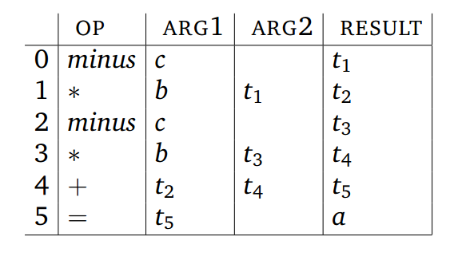
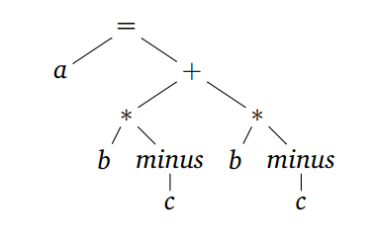
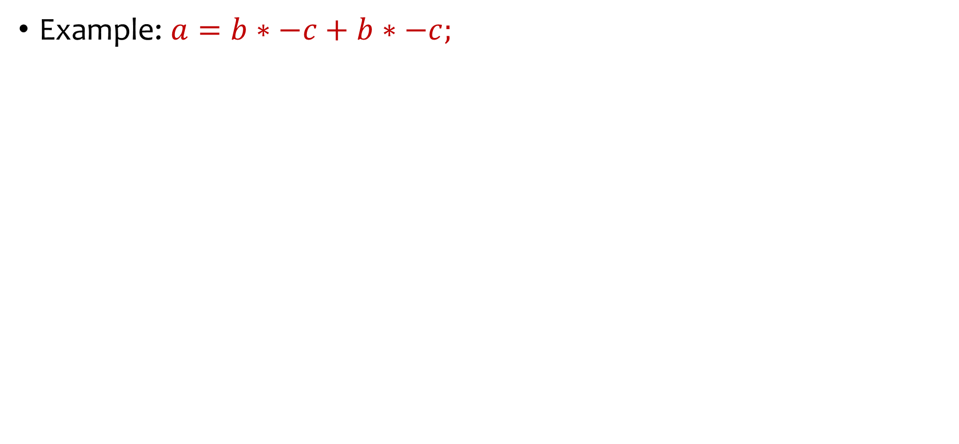
Quadruples
Example: $a=b∗−c+b∗−c;$
Syntax Tree
Three Address Code
Quadruples

Slide 31
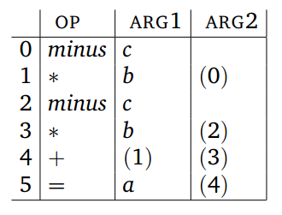
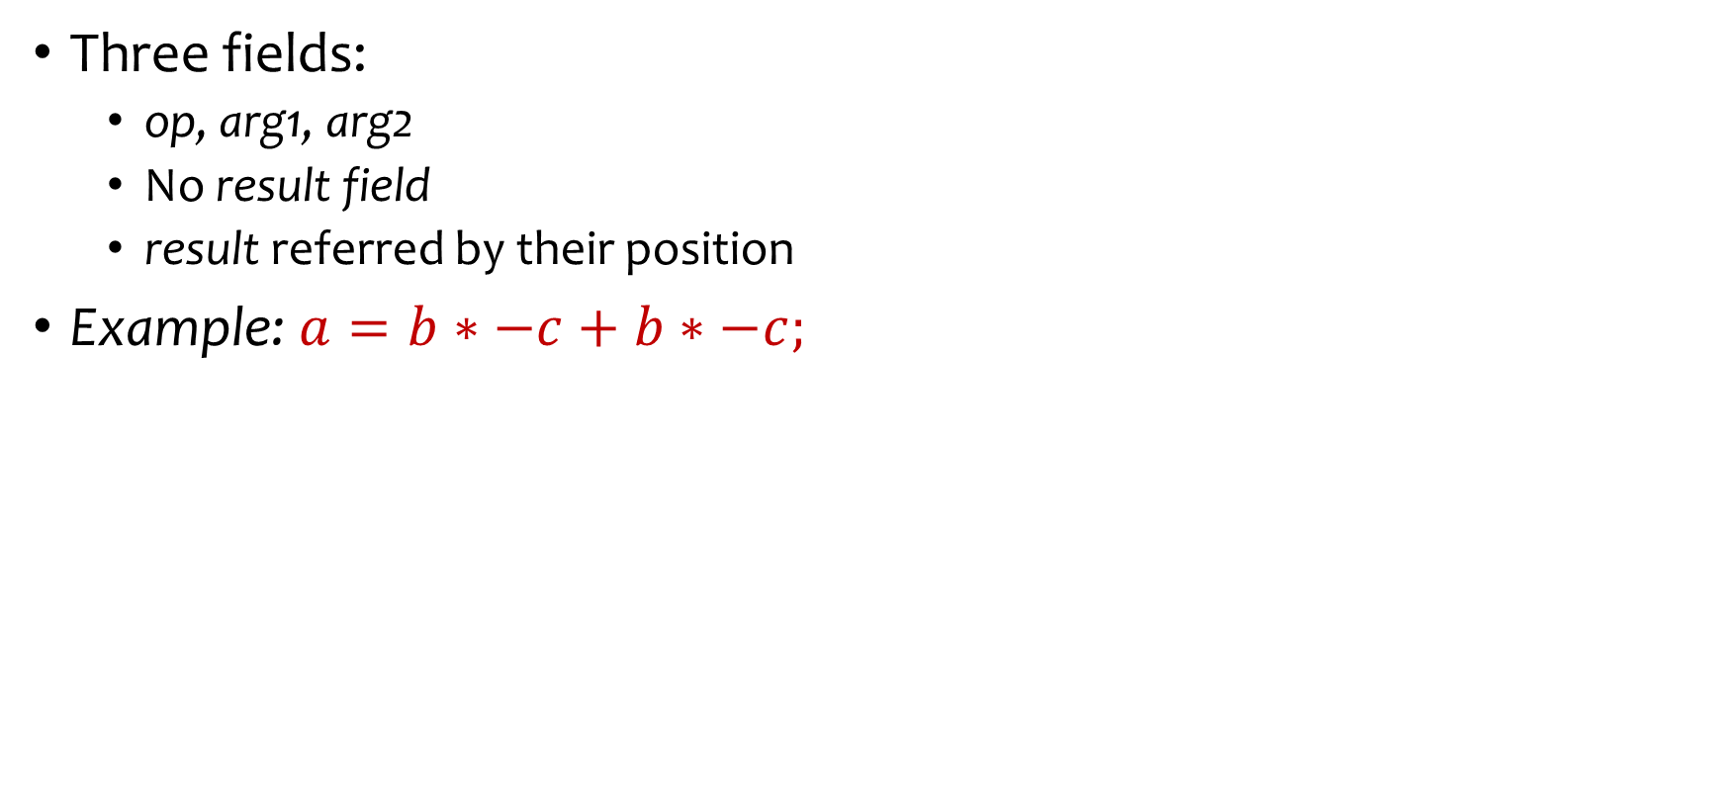
Triples
Three fields:
op, arg1, arg2
No result field
result referred by their position
Example: $a=b∗−c+b∗−c;$
Syntax Tree
Triples
Three Address Code

Slide 32
Triples
Optimization by moving instructions is difficult in Triples, but easy in Quadruples
Moving instructions forces to adjust the arguments where that position appear
Triples

Slide 33
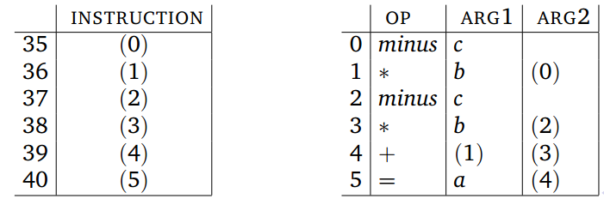
Indirect Triples
Listing pointers to the triples instead of triples
Triples
Indirect Triples

Slide 34
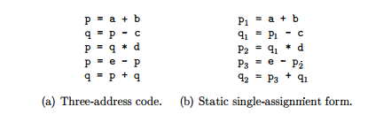
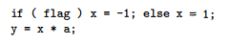
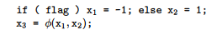
Static Single Assignment Form (SSA)
Another form of IR; facilitates code optimization
All assignments are to variables with distinct names
Φ functions to combine two definitions of the same variable x
SSA
SSA

Slide 35
Types and Declarations
Application of types
Type Checking
Uses logical rules to reason about the behavior of a program at run time
Ensures that the types of the operands match the type expected by an operator
Example: the && operator in java expects it two operands to be booleans; the result type is also boolean
Translation Applications
From the type of a name, a compiler can determine its required storage at runtime
Type information is also needed
to calculate the address denoted by an array reference
to insert explicit type conversion
to choose the right version of an arithmetic operator

Slide 36
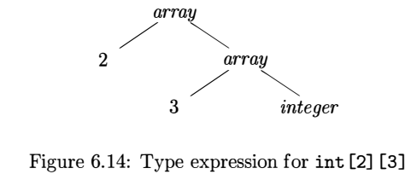
Type Expressions
Type expressions are used to represent structures of types
A type expression is either a basic type or is formed by applying an operator called a type constructor to a type expression
The sets of basic types and constructors depend on the language to be checked
Example: The array type int[2][3] can be
read as “array of two arrays of 3 integers each”
written as a type expression array(2,array(3,integer)
the operator array takes two parameters, a number and a type

Slide 37
Definition of Type Expressions
A basic type is a type expression such as boolean, float, char, integer and void
A type name is a type expression such as name of a record, structure or class
A type expression can be formed by applying the array type constructor to a number and a type expression
A record is a data structure with named fields. A type name can be formed by applying the record type constructor to the field names and their types
A type expression can be formed by using the type constructor → for function types.
s→t denotes “function from type s to type t
If s and t are type expressions, then their Cartesian product s x t is a type expression
Type expressions may contain variables whose values are t type expressions

Slide 38
Type Equivalence
Many type-checking rules have the form, “if two type expressions are equal then return a certain type else error”
When type expressions are represented by graphs, two types are structurally equivalent if and only if one of the following conditions hold
They are the same basic type.
They are formed by applying the same constructor to structurally equivalent types
One is a type name that denotes the other

Slide 39
Storage Layout for Local Names
From the type of a name, the amount of storage required for it during runtime can be determined
At compile time, these amounts can be used to assign each name a relative address
The type and relative address are saved in the symbol-table entry for the name
Data of varying length, such as strings, dynamic arrays is handled by reserving a known fixed amount of storage for a pointer to the data

Slide 40
Storage Layout for Local Names (2)
The width of a type is the number of storage units needed for objects of that type
we consider a byte as the smallest unit of addressable memory
A basic type, such as a character, integer, or float, requires an integral number of bytes
For easy access, storage for aggregates such as arrays and classes is allocated in one contiguous block of bytes

Slide 41
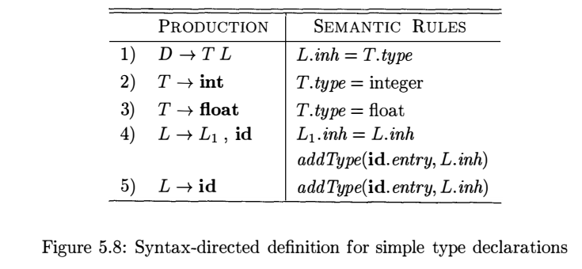
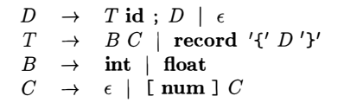
Computing Types and Their Widths
SDD for computing types (recall!)
Supports declarations like
int id, id, id
A modified grammar
Supports declarations like
int id; float id;
int[2][3][3] id;
record { int id; int[2][3] id2}

Slide 42
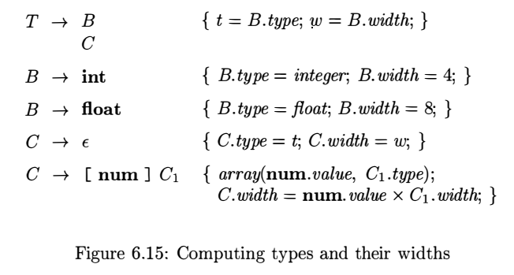
Computing Types and Their Widths
Productions
Semantic Actions
{T.type = C.type; T.width=C.width;}

Slide 43

Computing Types and Their Widths
Parse tree for the type int [2][3]
Productions
Semantic Actions

Slide 44




Computing Relative Addresses
CPP
ASM (x86-64 gcc 11.1)
SDT for computing relative addresses

Slide 45




Fields in Records and Classes
CPP
ASM (x86-64 gcc 11.1)
SDT for handling field names in records

Slide 46
Three Address Code Generation

Slide 47


An Example

Slide 48

Translation of Expressions
Need to convert an expression with more than one operator in source program to Three Address Codes with only one operator
$a∗b+c$
An array reference will expand in sequence of Three Address Codes that calculate the address for the reference
$A[i][j]$

Slide 49

Translation of Expressions
Production | SemanticRules
S → id:= E ; E → E₁+ E₂ E → E₁ * E₂ | $−$E₁ | ( E₁ ) | id
How can we write semantic rules that generate three address code for this grammar?
With help of two synthesized attributes
addr
code

Slide 50

Translation of Expressions
$S$has a synthesized attribute $code$
E has two synthesized attribute $code$&$addr$
$S.code$and$E.code$contains three address codes for $S$ and $E$ respectively
$E.addr$denotes address that will contain address of the value of $E$
Remember what an address is in Three Address Code?
Production | SemanticRules
S → id:= E ; E → E₁+ E₂ E → E₁ * E₂ | $−$E₁ | ( E₁ ) | id

Slide 51


Translation of Expressions
A Source C code
Corresponding Three Address Code

Slide 52

Translation of Expressions
gen(…) builds an instruction and returns it

Slide 53


Translation of Expressions
An Example Expression: $a:= −(b)+c$
:=
We want to generate the
following code
a
+
t₂
$t1 =$minus$b$
$$t2= t1 + c$$
$a= t2$
t₁
-
c
b

Slide 54










Translation of Expressions
S.code$: t1=$minus $b|| t2 = t1+c || a = t2$
An Example Expression: $a:= −(b)+c$
S
E.addr : $t2$
E.code : $t1=$ minus$b || t2 = t1+c$
id.lexeme: $a$
id
:=
E
E
E.addr : $t1$
E.code : $t1 =$minus $b$
+
E
E.addr : $c$
E.code :“”
-
E
E.addr : $b$
E.code :“”
(
)
E
E.addr : $b$
E.code :“”
id
id.lexeme: $c$
id
id.lexeme: $b$

Slide 55

Incremental Translation
Code attributes can be long strings, so they are usually generated incrementally
Instead of building up E.code, generate only the new three address instructions
The function gen(…), in addition to constructing new instruction, append to the stream
Generating three-address code for expressions incrementally

Slide 56
Addressing Array Element
In C and Java, array elements are numbered 0,1,….,n-1, for an array of n elements
If the width of each array element is w, then the i-th element of array A begins in location
The above formula generalized to k-dimensions as
For the array, int A[5][7][8], location of A[2][3][4] will be
base + i x w
Here base is the relative address of A[0]
base + i₁ x w₁ + i₂ x w₂ + …+ i_{k} x w_{k}
base + 2 x 224 + 3 X 32 + 4 x 4
Here size of integer is assumed as 4 byte

Slide 57



Translation of Array References
The chief problem in generating code for array references is to related the address calculation formulas to a grammar for array references
For the array a declared as int[2][3], three-address translation of the expression –
We will use the following grammar production rule where nonterminal L generates an array name followed by a sequence of index expression.

Slide 58

Translation of Array References (2)
Attributes of L
L.addr - a temporary that holds the sum of the terms i_{k} x w_{k}
L.array - a pointer to the symbol-table entry for the array name
L.type - type of the subarray generated by L

Slide 59

Translation of Array References (2)

Slide 60
Control Flow
We will translate control flow statements such as if-else, while
Translation of control flow statements are tied with Boolean expressions
Boolean expression composed of Boolean operators
Boolean operator are applied to
Boolean variables
Relational expression with relational operator

Slide 61
Boolean Expression
We consider Boolean Expression generated by following grammar
rel is relational operator which is any one of < , > , <= , >= , ==, !=
We assume &&, || are left associative and precedence order if !, && then ||

Slide 62
Boolean Expression
Boolean expressions are used to
Alter flow of control
If (E) the S: E must be true to reach S
To compute logical values
True or False as value

Slide 63
Short Circuit Code
Also called jumping code
&&, || and ! are translated into jumps
The operators don’t appear in the code
The value of a boolean expression is represented by a position in the code

Slide 64

Short Circuit Code
Example:
A statement with Boolean expression
Jumping Code

Slide 65


Flow of Control Statements
We will consider flow of control statements generated by following grammar
$B$ represent Boolean expression
$S$ represent Statements

Slide 66
Flow of Control Statements
Attributes of SDD that will translate this grammar:
Codes are managed using
B.code : contains codes of B
S.code : contains codes of S
Jumping Labels are managed using
B.true : label to which control flows if B is true
B.false : label to which control flows if B is false
S.next : label of a instruction immediately after S
Synthesized
Inherited

Slide 67


Flow of Control Statements
Code Structure for production $S→if (B) S1$

Slide 68


Flow of Control Statements
Code Structure for production $S→if \left(B\right) S1 else S2$

Slide 69


Flow of Control Statements
Code Structure for production $S→while \left(B\right) S1$

Slide 70

Flow of Control Statements
The Grammar
Productions | Semantic Rules
$$P→ S$$
$$S→assign$$
$$S→if \left(B\right) S1$$
$$S→if \left(B\right) S1 else S2$$
$$S→while \left(B\right)S1$$
$$S→S1 S2$$
assign is a Placeholder for
an assignment statement
We need to find out the Semantic Rules

Slide 71



Flow of Control Statements
Semantic Rules for the first two productions
$newlabel()$ creates
new label each time it is called
Productions | Semantic Rules
$$P→ S$$ | $$S.next=newlabel( )$$ $$P.code=S.code \left| \right| label(S.next)$$
$$S→assign$$ | $$S.code=assign.code$$
$label(L)$ attaches label L to the next instruction to be genetated

Slide 72


Flow of Control Statements
Semantic Rules for the production $S→if (B) S1$
Productions | Semantic Rules
$$S→if \left(B\right) S1$$ | $$B.true=newlabel\left( \right)$$ $$B.false=S1.next=S.next$$ $$S.code=B.code \left| \right| label\left(B.true\right)$$ $$\left| \right| S1.code$$

Slide 73


Flow of Control Statements
Semantic Rules for the production $S→if \left(B\right) S1 else S2$
Productions | Semantic Rules
$$S→if \left(B\right) S1 else S2$$ | $$B.true=newlabel\left( \right)$$ $$B.false=newlabel\left( \right)$$ $$S2.next=S1.next=S.next$$ $$S.code=B.code$$ $$\left| \right| label\left(B.true\right) \left| \right| S1.code$$ $$\left| \right| gen\left(′goto^{′} S.next\right)$$ $$\left| \right|label\left(B.false\right)\left| \right| S2.code$$

Slide 74


Flow of Control Statements
Semantic Rules for the production$S→while \left(B\right) S1$
Productions | Semantic Rules
$$S→while \left(B\right)S1$$ | $$begin=newlabel( )$$ $$B.true=newlabel\left( \right)$$ $$B.false=S.next$$ $$S1.next=begin$$ $$S.code=label\left(begin\right)$$ $$| |B.code \left| \right| label\left(B.true\right)$$ $$\left| \right| S1.code\left| \right| gen\left(′goto^{′} begin\right)$$

Slide 75

Flow of Control Statements
Semantic Rules for the last production
Productions | Semantic Rules
$$S→ S1 S2$$ | $$S1.next=newlabel\left( \right)$$ $$S2.next=S.next$$ $$S.code=S.code \left| \right| label\left(S1.next\right)\left| \right| S2.code$$

Slide 76

Translation of Boolean Expression
Now we will consider productions containing $B$ in their head
We want to know how we produce $B.code$
How to produce B.code?

Slide 77

Translation of Boolean Expression
The Grammar
Productions | Semantic Rules
$$B→B1 \left| \right| B2$$
$$B→B1 \&\& B2$$
$$B→!B1$$
$$B→E1 rel E2$$
$$B→true$$
$$B→false$$

Slide 78

Translation of Boolean Expression
Consider $B→B1 \left| \right| B2$
If $B1$ is true then $B$ is also true. So label of $B1.true$ is same as $B.true$
If $B1$ is false, then we need to evaluate $B2$. So label of $B1.false$ is the label of first instruction of $B2$
$B2.true$ is same as $B.true$
$B2.false$ is same as $B.false$

Slide 79



















Translation of Boolean Expression
Consider $B→B1 \left| \right| B2$
to $B .true$
to $B.true$
$$B1.code$$
to $B1.false$
$$B.code$$
to $B.false$
$B1.false$:
to $B .true$
$$B2.code$$
$B.true$:
to $B .false$
$$S1.code$$
$B.true$:
$$S1.code$$
$B.false$:
...
$B.false$:
...
Code Structure for $if(B) S1$
Code Structure for $if (B1 || B2) S1$

Slide 80


Translation of Boolean Expression
Semantic Rules for the production $B→B1 | | B2$

Slide 81


Translation of Boolean Expression
Semantic Rules for the production $B→B1 \&\& B2$

Slide 82


Translation of Boolean Expression
Semantic Rules for the production $B→!B1$

Slide 83


Translation of Boolean Expression
Semantic Rules for the production $B→E1 rel E2$

Slide 84


Translation of Boolean Expression
Semantic Rules for the productions $B→true$ and $B→false$

Slide 85

Translation of Boolean Expression
Example:
Matched Production:
$S→ if \left(B\right) S1$
$B$ derived $x < 100 || x >200 \&\& x != y$
$S1$ derived $x = 0$

Slide 86
P
B.code:
if x <100 goto L2
goto L3
L3:if x >200 goto L4
goto L1
L4: if x != y goto L2
goto L1
S.next = newlabel() = L1
S
S1
if
(
)
B.code:
if x >200 goto L4
goto L1
L4: if x != y goto L2
goto L1
B
B.true= newlabel() = L2
B.false = S.next = L1
B.true = B.true = L2
B.false = newlabel() = L3
||
B
B.true = B.true = L2
B.false = B.false = L1
B
B.true = B.true = L2
B.false = B.false = L1
B.true = newlabel() = L4
B.false = B.false
relop : <
B
&&
B
E
E
relop: !=
if x <100 goto L2
goto L3
relop: >
E
E
x
100
E
E
if x != y goto L2
goto L1
if x >200 goto L4
goto L1
x
200

Slide 87
S.code
if x <100 goto L2
goto L3
L3:if x >200 goto L4
goto L1
L4: if x != y goto L2
goto L1
L2: S1.code \\ x := 0
P.Code = S.code ||
L1:
P
S
S1
if
(
)
B
B.true= newlabel() = L2
B.false = S.next = L1
B.code:
if x <100 goto L2
goto L3
L3:if x >200 goto L4
goto L1
L4: if x != y goto L2
goto L1

Slide 88

SDD for Generating Three Address Code for Flow-of-Control Statements

Slide 89

SDD for Generating Three Address Code for Booleans

Slide 90

Avoiding Redundant Gotos

Slide 91



Avoiding Redundant Gotos

Slide 92



Avoiding Redundant Gotos

Slide 93



Avoiding Redundant Gotos

Slide 94

Boolean Values and Jumping Code
So far we have use boolean expressions to alter the flow of control in statements
A boolean expression may also be evaluated for its value such as

Slide 95
Boolean Values and Jumping Code
A clean way of handling both roles of boolean expressions is to first build a syntax tree for expressions, using either of the following approaches
Use two passes
– Construct a complete syntax tree for the input, and
– then traverse in depth-first order computing the translations specified by the semantic rule
Use one pass for statements, but two passes for expressions
– In the approach, we would first translate E in while (E) S1 before S1 is examined.
– The translation of E, however would be done by building its syntax tree and then walking the tree
Use separate code generation functions for expressions
One for generating jumping code
The other for computing the value

Slide 96
Backpatching
A key problem when generating code for boolean expression and flow-of-control statement is that of matching a jump instruction with the target of the jump
The SDD we have used earlier generates symbolic labels
A separate pass is needed to bind labels to address
100:
106
101:
102
102:
104
103:
107
104:
106
105:
107
106:
107:

Slide 97
Backpatching
Backpatching is used to generate code for boolean expressions and flow-of-control statements in one pass
In Backpatching, list of jumps are passed as synthesized attributes
Specifically, when a jump is generated, the target of the jump label is left unspecified
Each such jump is put on a list of jumps whose labels are to be filled in when proper label can be determined
All of the jumps on a list have the same target label

Slide 98
Code Generation Using Backpatching
Two synthesized attributes for boolean expression B
B. truelist – a list of jumps or conditional jumps into which we must insert the label to which control goes if B is true
B. falselist – a list of jumps or conditional jumps into which we must insert the label to which control goes if B is false
A synthesized attribute for statement S
S. nextlist – a list of jumps to the instruction immediately following the code for S
Three functions
makelist(i) – creates a new list containing only I, an index into the array of instructions. Returns a pointer to the newly created array
merge(p1, p2) – concatenates the lists pointed to by p1 and p2, and returns a pointer to the concatenated list
backpatch(p, i) – inserts i as the target label for each of the instructions on the list pointed to by p

Slide 99












Backpatching for Boolean Expression
L

Slide 100

Backpatching for Boolean Expression

Slide 101

Backpatching for Boolean Expression

Slide 102

Backpatching for Flow-of-Control Statements

Slide 103
Backpatching for Flow-of-Control Statements

Slide 104
Reference
Compilers: Principles, Techniques, & Tools, by
Alfred B. Aho, Monica S. Lam, Ravi Sethi, Jeffrey D. Ullman
Chapter 6
6.1
6.2
6.3
6.4
6.6
6.7

Slide 105
Thank You!

